Slide 1

Employee Turnover Prediction
Data Science Project
By Aljowhara Alblaihed

Slide 2

Part 1:
Table of Contents
What is Employee Turnover
Part 2:
Business Problem
Part 3:
Process
Part 4:
Exploratory Data Analysis
Part 5:
Model Results
Part 6:
Tools

Slide 3

What is Employee Turnover

Slide 4

WHAT IS EMPLOYEE TURNOVER?
Employee Turnover rate is the measurement of the total number of employees who leave an organization during a certain period of time. Employee Turnover Prediction means to predict whether an employee is going to leave or not leave the organization in the coming period.

Slide 5
Business Problem

Slide 6
BUSINESS PROBLEM
Project objective is to predict whether the employee is going to leave or not leave the organization in the coming period based on various features includes satisfaction rate, evaluated performance by the employer, number of projects completed while at work, average monthly hours at workplace, time spent at the company in years, whether the employee had a workplace accident, whether the employee was promoted in the last five years, department in which they work for, salary level of the employee.

Slide 7
Process

Slide 8
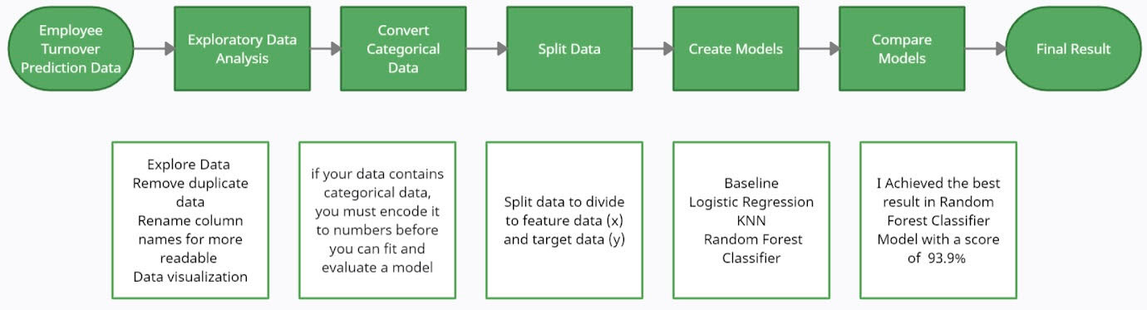
PROCESS

Slide 9
Exploratory Data Analysis

Slide 10
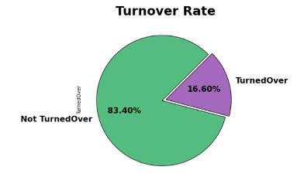
Exploratory Data Analysis
83.40% of employees stayed (not turnover) and 16.60% of employee left the company (turnover).
have an uneven class distribution.

Slide 11
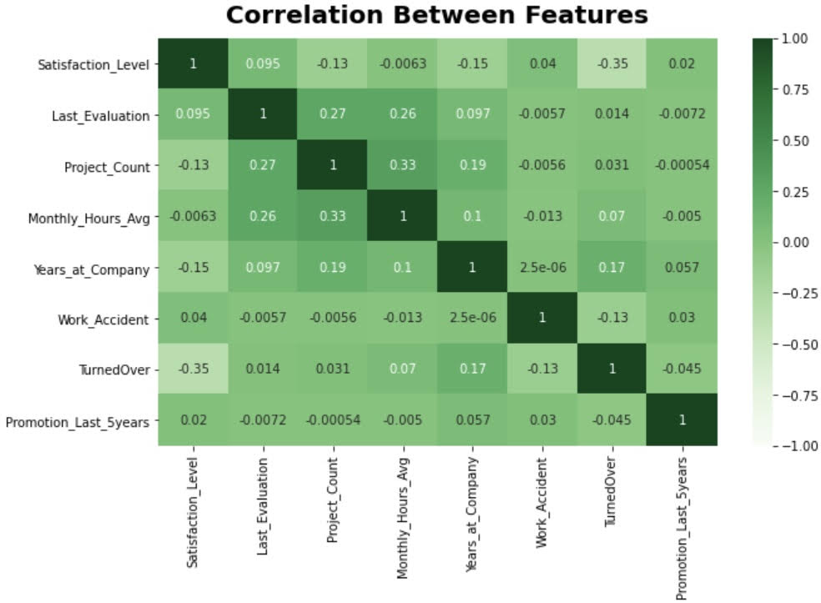
Exploratory Data Analysis
The most influential factor was employee satisfaction rate and which had a score of 0.35.

Slide 12
Model Results

Slide 13
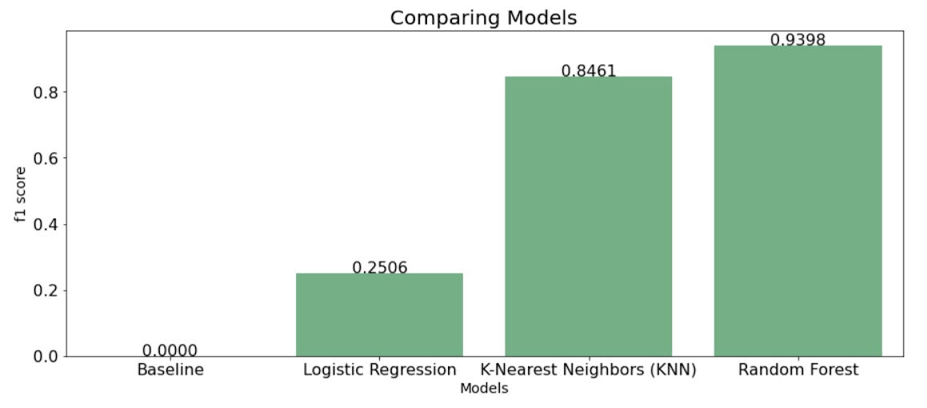
Model Results
Achieved the best result in Random Forest Classifier Model and had a score of 93.9%.
The baseline Model was very poorly performing and f1 score is 0.
F1 score is usually more useful than accuracy, especially if you have an uneven class distribution.

Slide 14
Tools

Slide 15





TOOLS

Slide 16

Recruit more doctors.
Thank you
Our first key focus.
Project link: https://github.com/AljowharaAlblaihed/Employee-Turnover-Prediction

